Slide 1
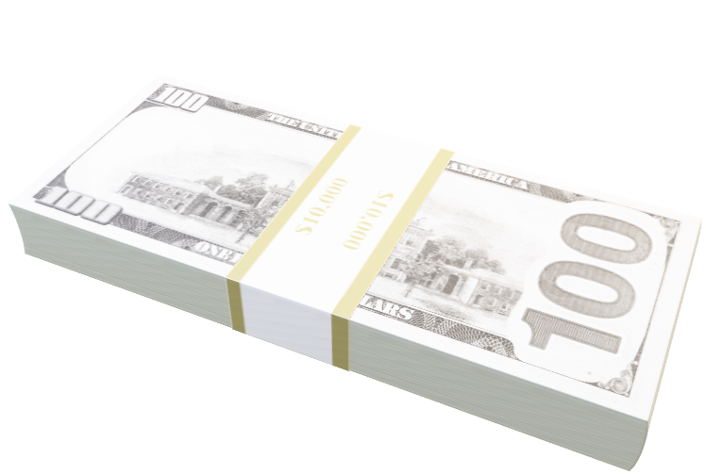
Stocks trading technical indicators strategies
MBAI 5300G - PROGRAMMING AND DATA PROCESSING
Group 9

Slide 2


Group members
Huy Nguyen
Chris gell
linkedin.com/in/quanghuynghua
linkedin.com/in/chris-gell-1b4080255/

Slide 3
Table of contents
1
2
3
4
Rsi & pocket pivot
Momentum
A combination of RSI, and Pocket Pivot Points
Buy the top performers of Nasdaq-100
Cluster & ichimoku
Golden Cross
Categorize stocks based on volatility and return.
Utilize Ichimoku cloud.
Trade high period SMAs (50 & 200)
5
Bollinger Bands
6
Q & A
Range-bound logic

Slide 4
disclaimer !!!
The content does not include
financial advice, guidance or recommendations to take, or not to take, any trades, investments or decisions in relation to any matter.

Slide 5
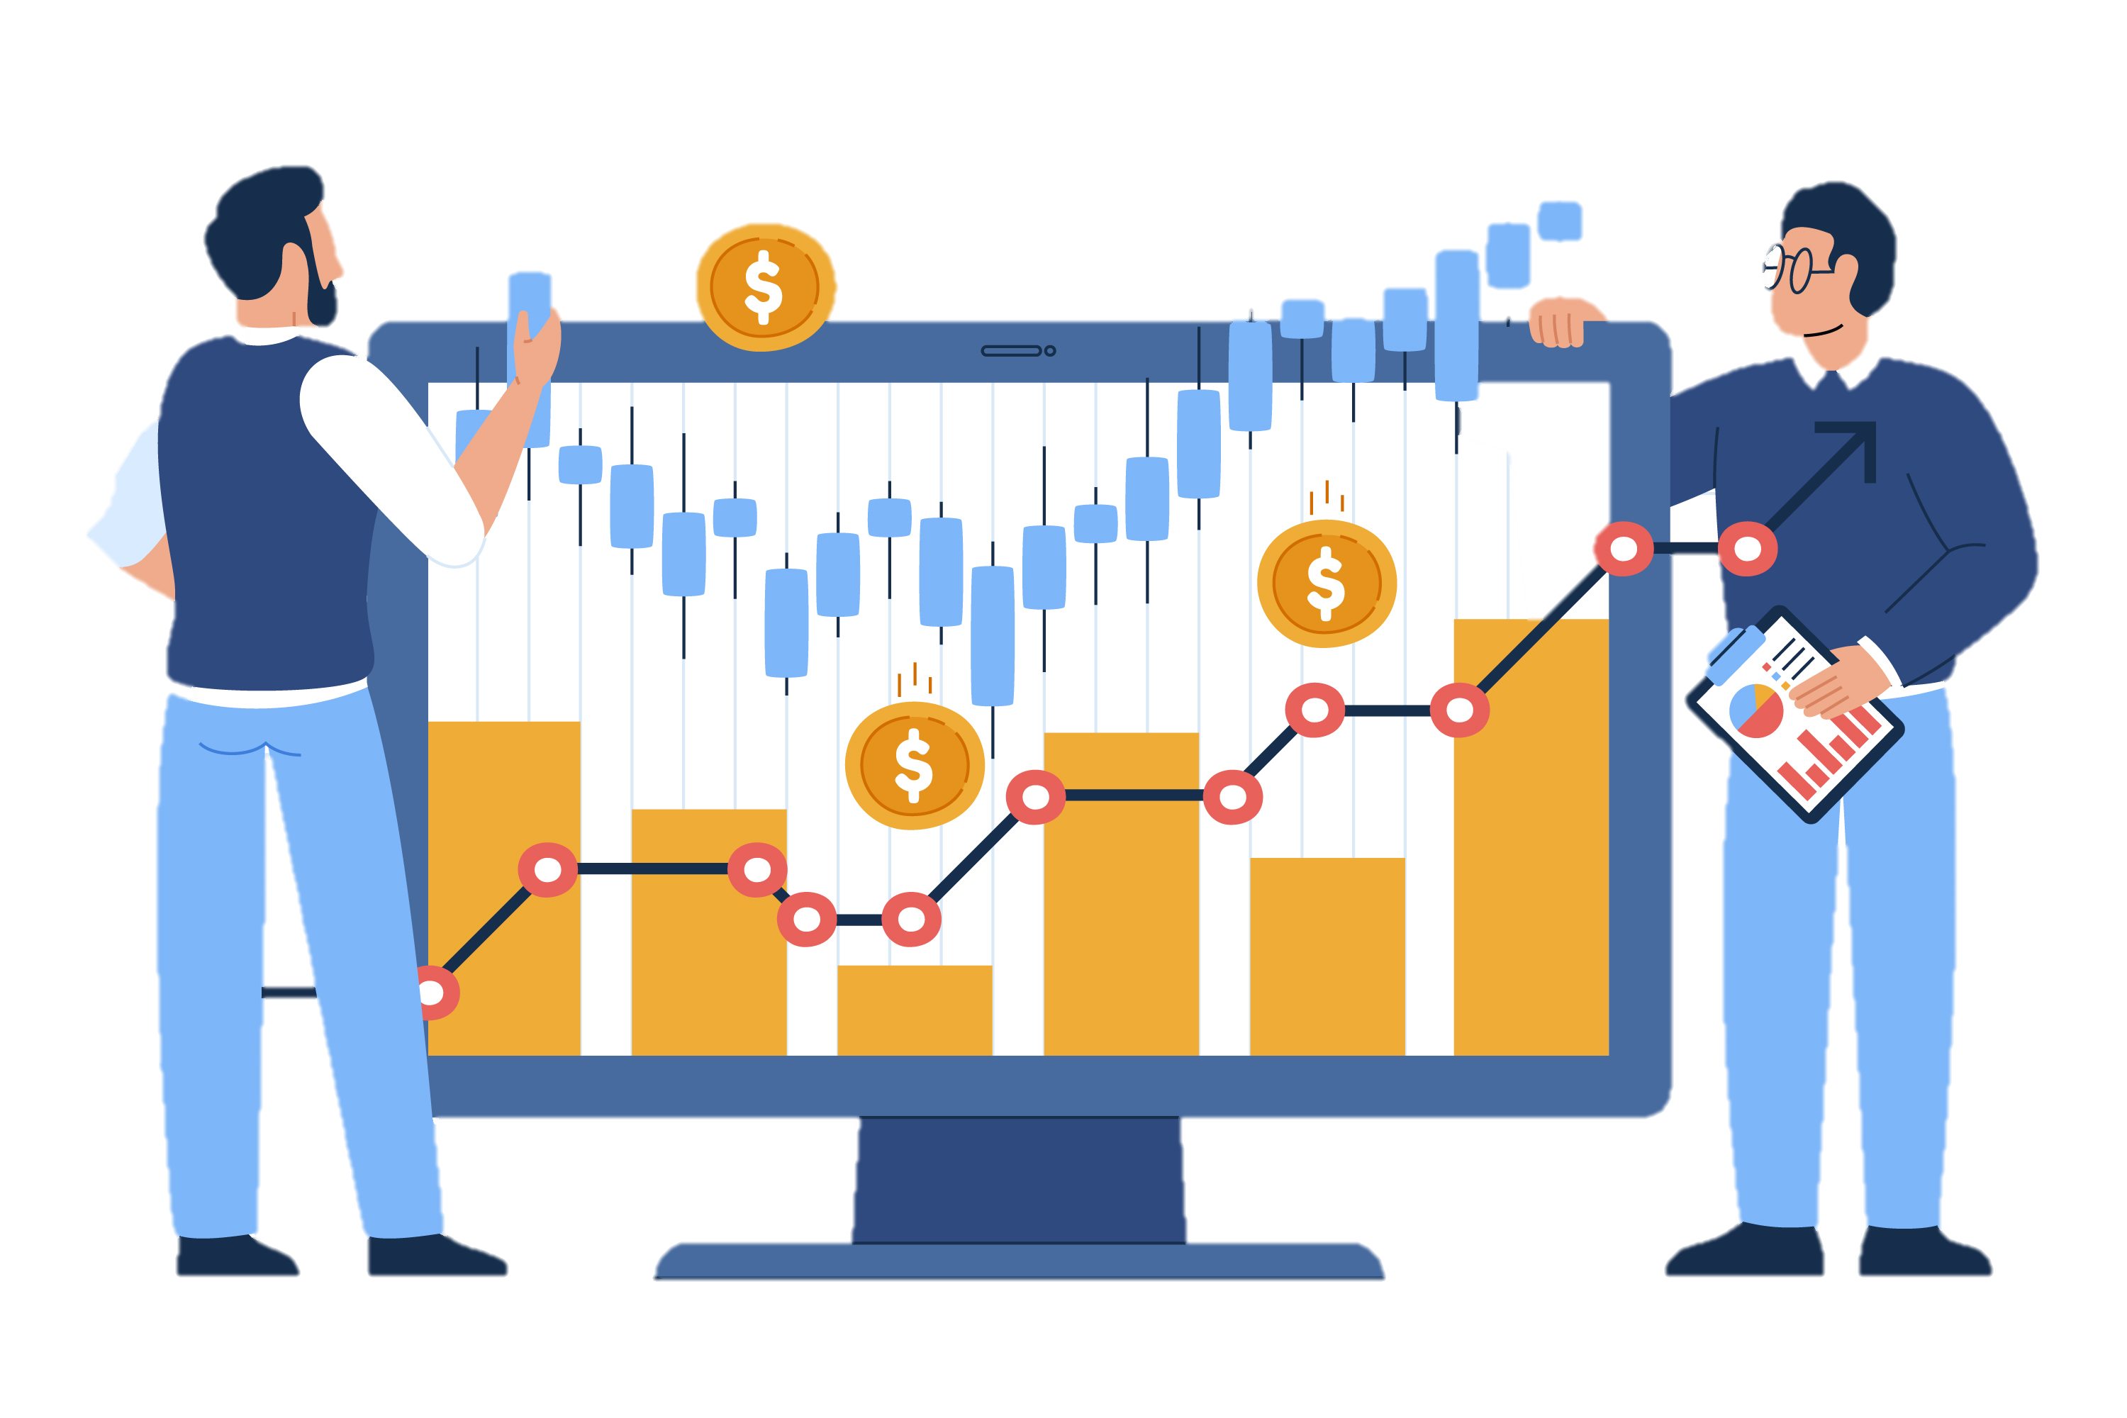
1
RSI & Pocket pivot
A combination of RSI and Pocket Pivot Points

Slide 6
Strategy #1
Get the top 10 stocks based on market cap
Determine whether to buy or sell with the signals generated from 2 indicators
Compare cumulative product with Mutual Fund

Slide 7
Indicators
Relative Strength Index (RSI)
Pivot Pocket Points

Slide 8
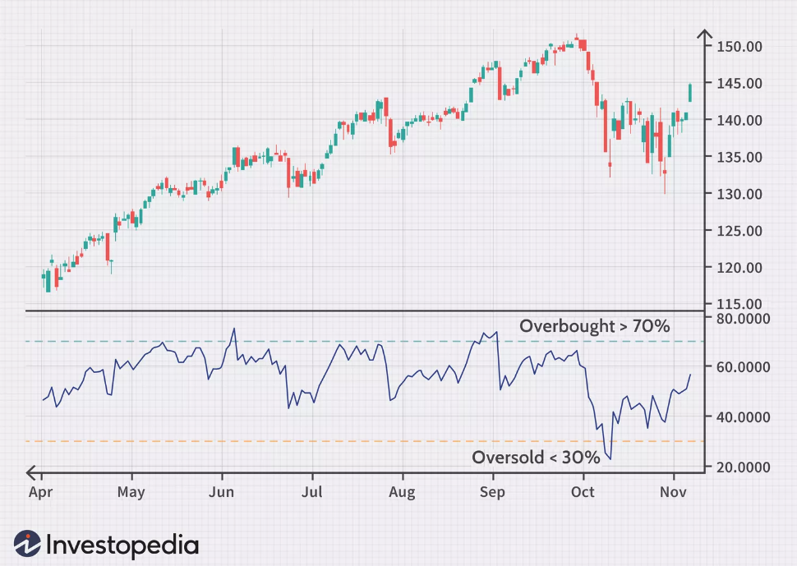
Indicators
Relative Strength Index (RSI)
RSI measures the speed and magnitude of a security's recent price changes to evaluate overvalued or undervalued conditions in the price of that security.
Notes:
The RSI is displayed as an oscillator (a line graph) on a scale of zero to 100.
The RSI can do more than point to overbought and oversold securities. It can also indicate securities that may be primed for a trend reversal or corrective pullback in price. It can signal when to buy and sell. Traditionally, an RSI reading of 70 or above indicates an overbought situation. A reading of 30 or below indicates an oversold condition.
The standard number of periods used to calculate the initial RSI value is 14.

Slide 9
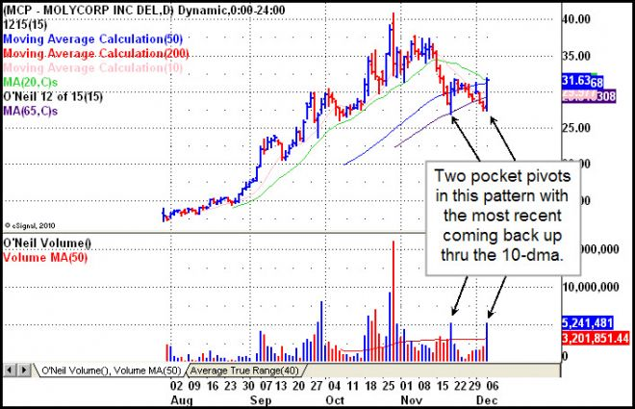
Indicators
Pocket Pivot
Pocket Pivot is the current up day’s volume must be larger than any of the down volume days in the prior 10 days.

Slide 10
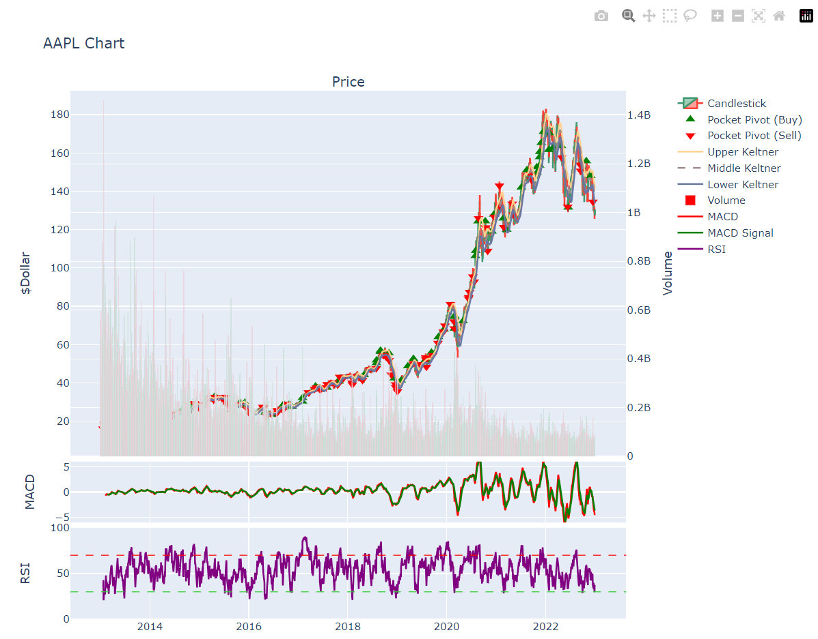
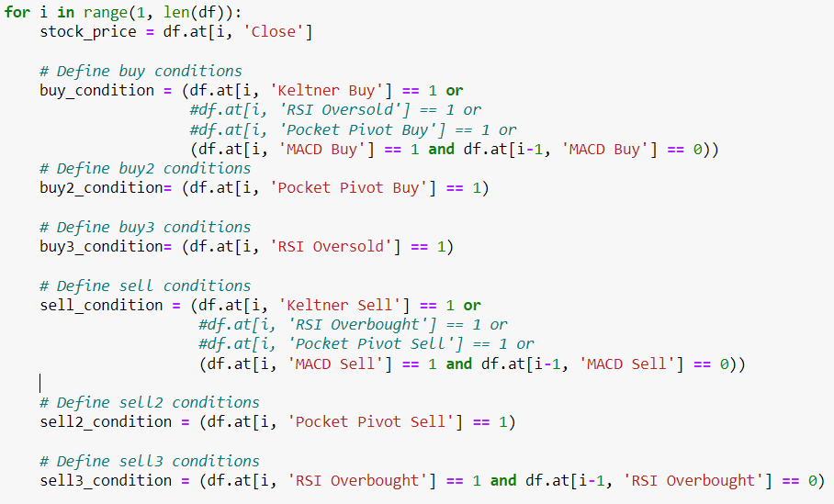
Set trade condition

Slide 11
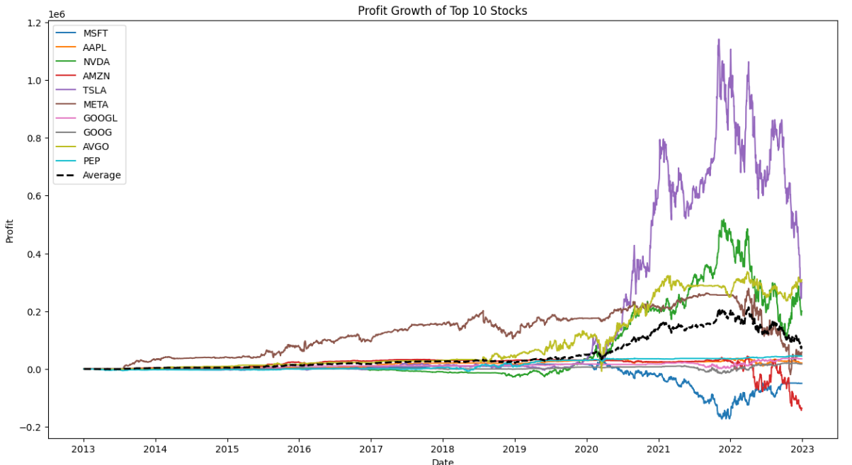
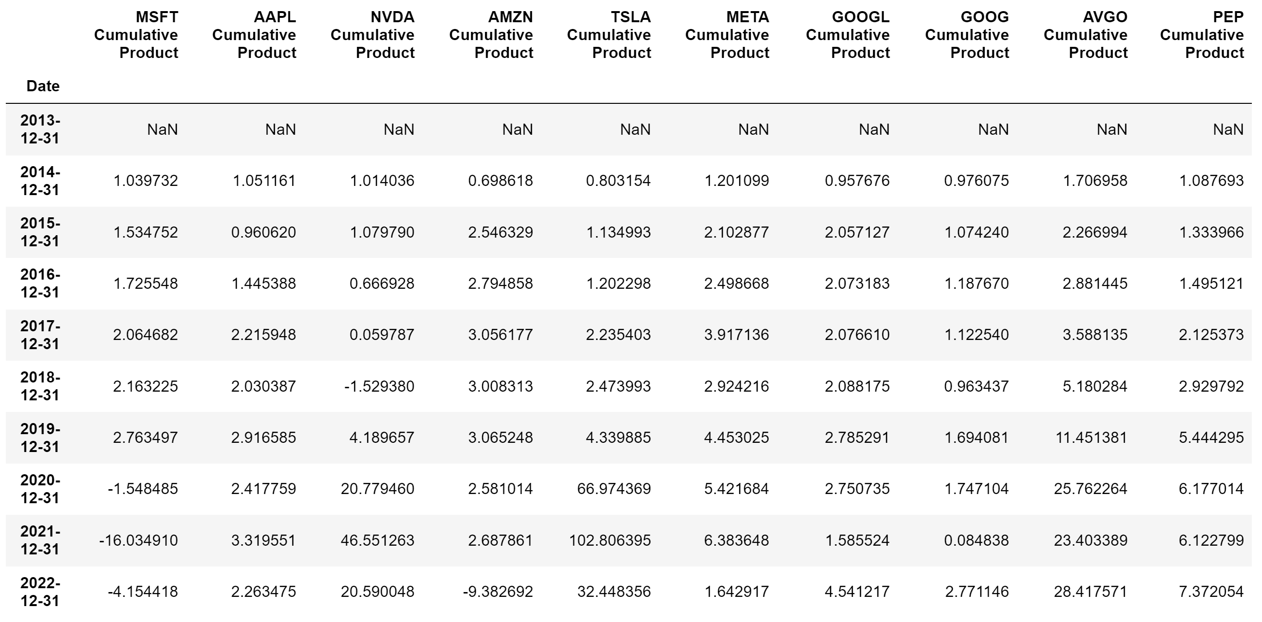
Summary of 10 stocks return

Slide 12
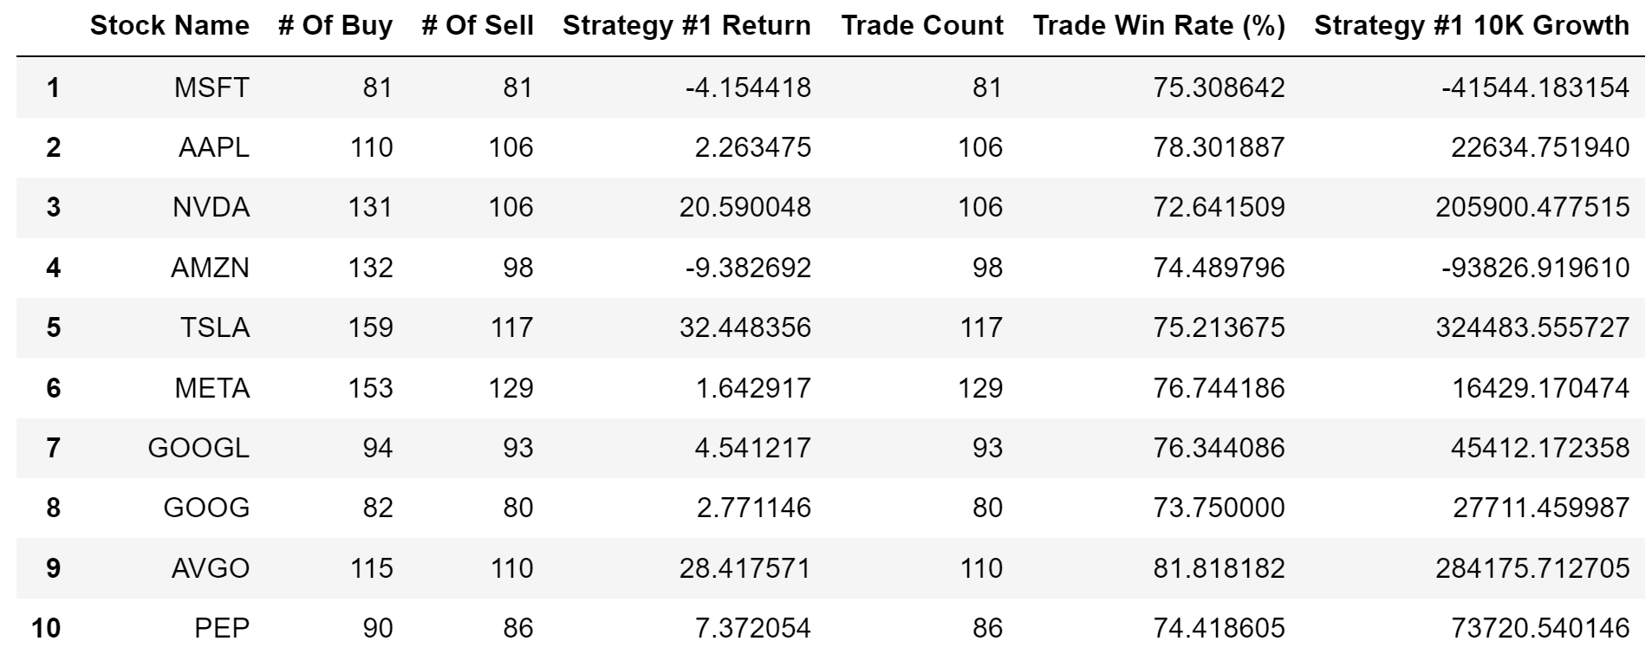
Summary of return of 10 stocks
Notes:
Average yearly

Slide 13
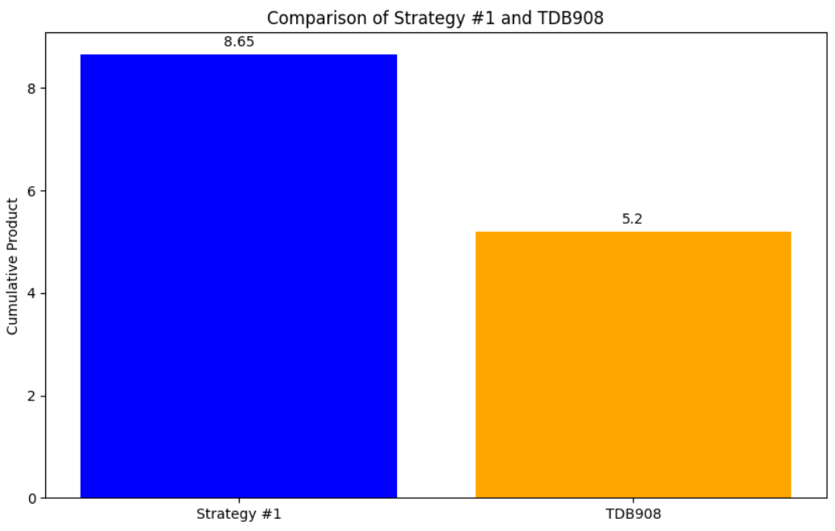
Comparision cumprod 10 years
Notes:
Average yearly

Slide 14




2
Momentum
Buy the top performers of Nasdaq-100

Slide 15
Strategy #2
Selling losers, buying winners!
Crawl ticker list of Nasdaq-100 from each year.
Get the top 10 stocks base on returns of previous 12 months.
Buy at the start of the month and sell at the end of the same month.
Get the monthly average return and yield the cumulative product.

Slide 16
$27,310
IS THE RETURN YOU’VE GOT WITH AN INITIAL INVESTMENT OF $10K
CUMULATIVE PRODUCT OF 2.73X OVER A 5-YEAR-PERIOD

Slide 17
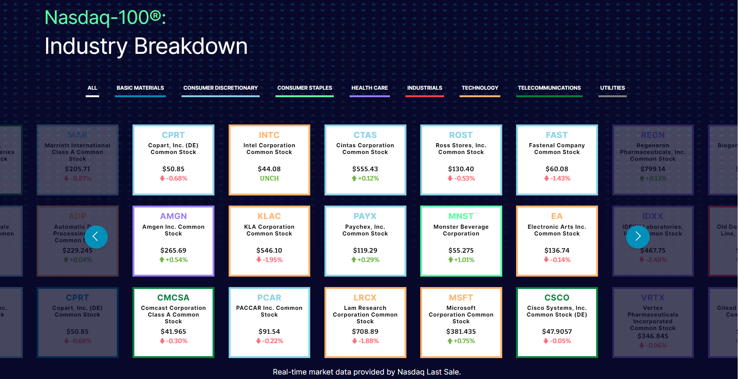
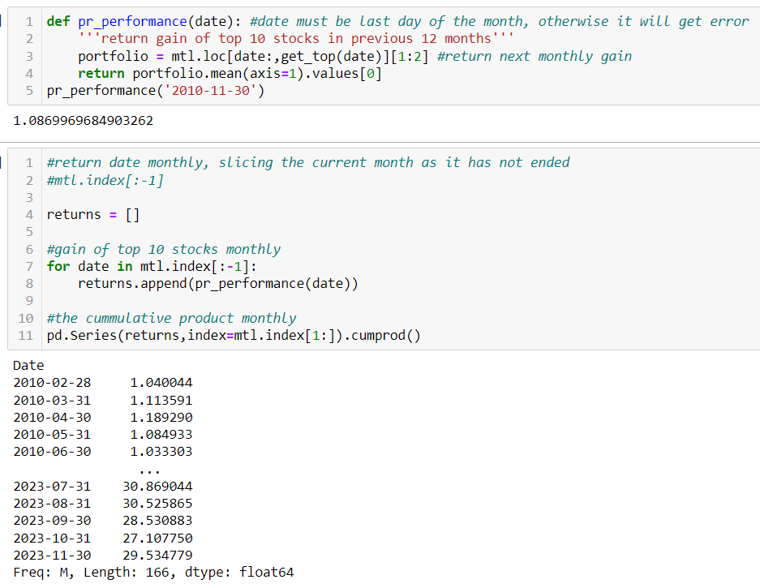
Use current Nasdaq-100
The cumprod() 29.53x is unrealistic as I pick the current Nasdaq-100 and do the analysis on the past price.

Slide 18
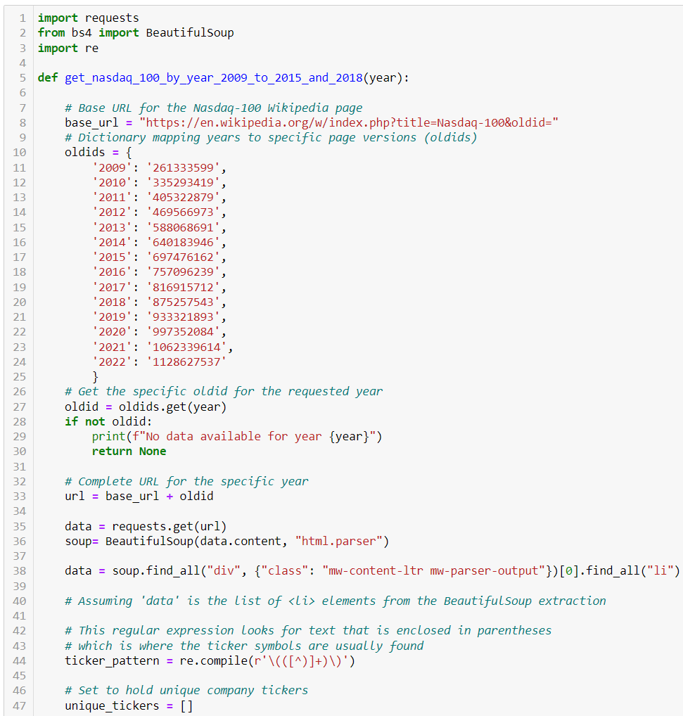
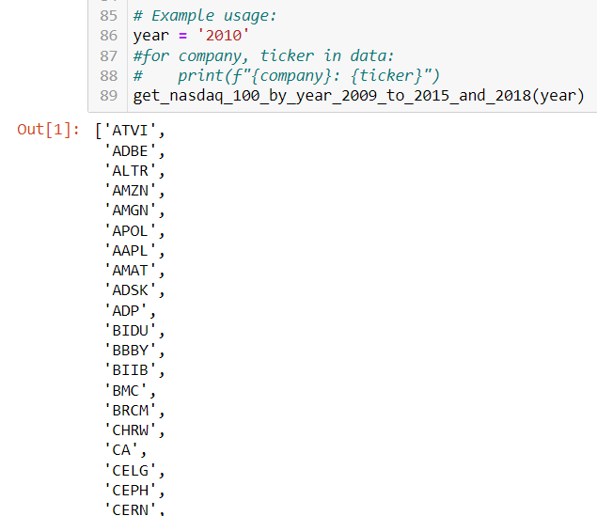
CRAWL TICKERS
Using BeautifulSoup library, I crawl ticker list from Wikipedia history pages.

Slide 19
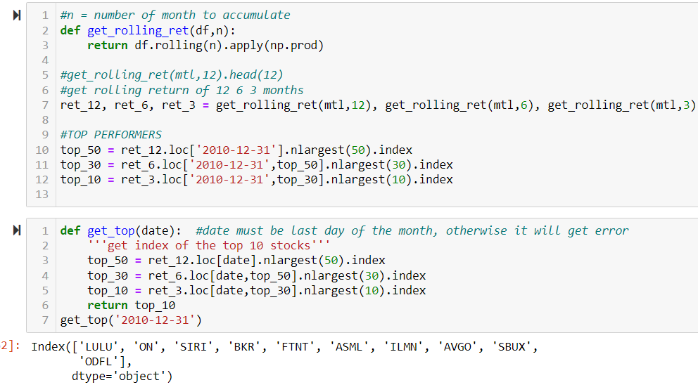
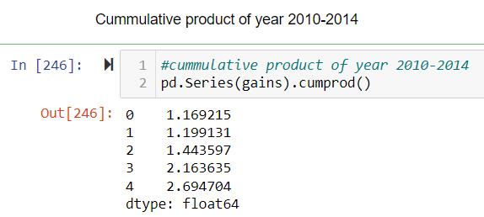
Get top 10 stocks
Based on previous 12-continuous-month performance, I filter the top 10 stocks and buy it, sell it at the end of the month.

Slide 20
BEST 5 YEAR RETURN
2.73X
2.07X
2.22X
MOMENTUM
NDX
TDB908
Our Strategy
Nasdaq index performance
TD Nasdaq Index Mutual Fund
Notes:
MOMENTUM: 2010-2014 TDB908 November 2016 - November 2021

Slide 21
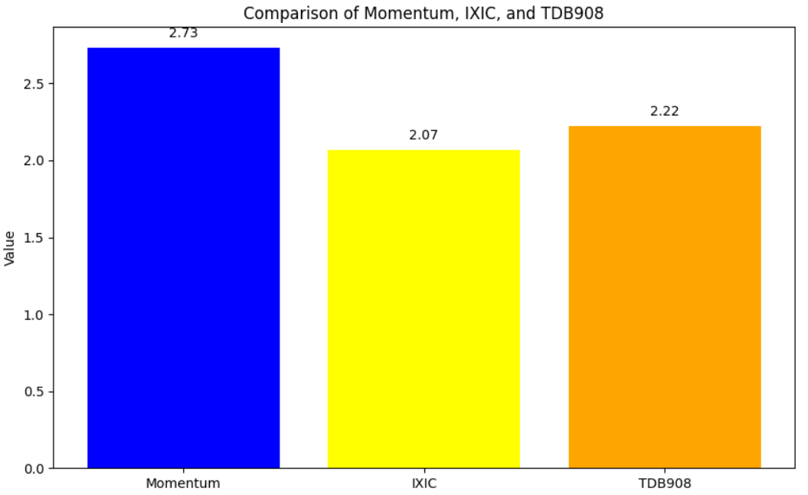
BEST 5 YEAR RETURN cumprod
Notes:
MOMENTUM: 2010-2014 TDB908 November 2016 - November 2021

Slide 22


3
Cluster & ichimoku
Categorize stocks
based on volatility and return.
Utilize Ichimoku cloud.

Slide 23
Strategy #3
Crawl the Nasdaq-100 list.
Use Cluster Algorithm (KMeans) to categorize stocks into groups, based on returns and variance.
Use Ichimoku Cloud to decide when there is a buy or sell.

Slide 24
$24,800
IS THE RETURN YOU’VE GOT WITH AN INITIAL INVESTMENT OF $10K
CUMULATIVE PRODUCT OF 2.48X OVER A 10-YEAR-PERIOD

Slide 25
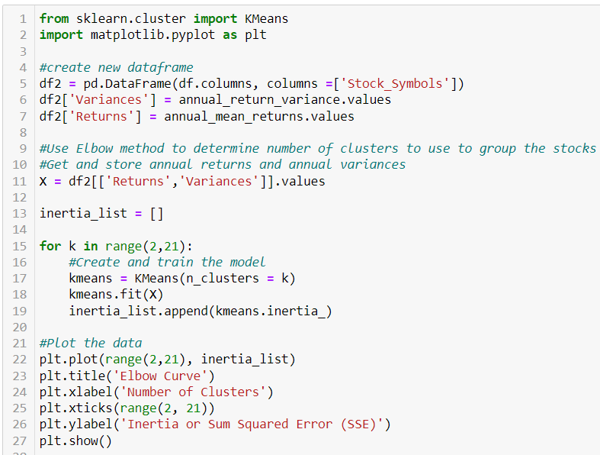
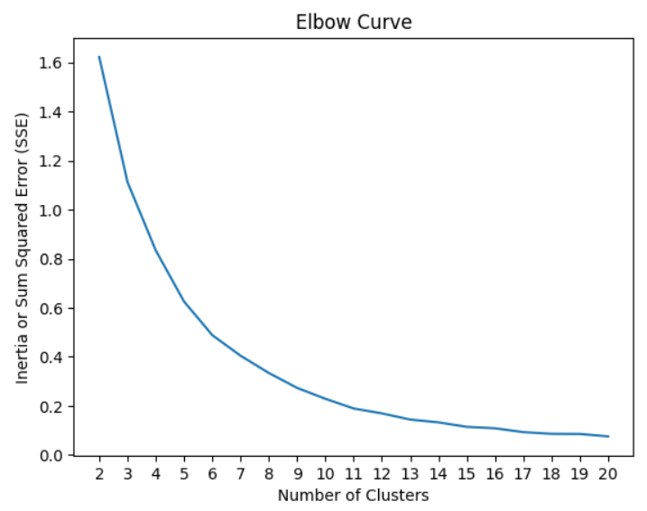
Determine cluster number
Elbow curve method is a commonly used technique to determine the optimal number of clusters in a clustering analysis, such as K-means clustering.
Notes:
It is a graphical method that helps you find the "elbow point" on a plot of the within-cluster sum of squares (WCSS) or the sum of squared distances between data points and their assigned cluster centroids.

Slide 26
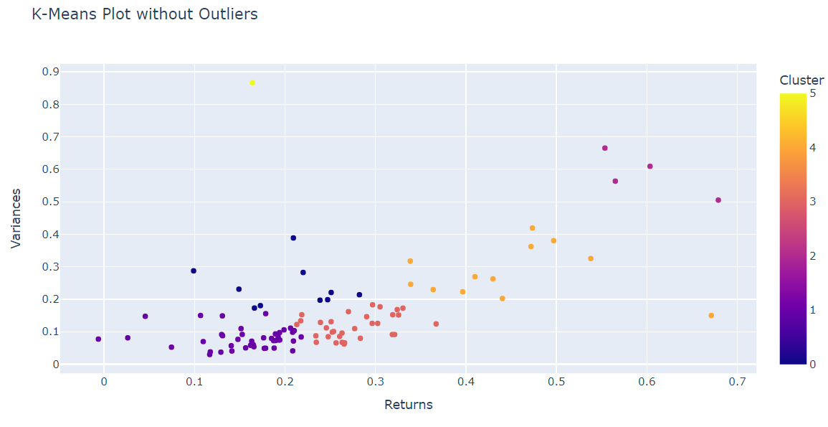
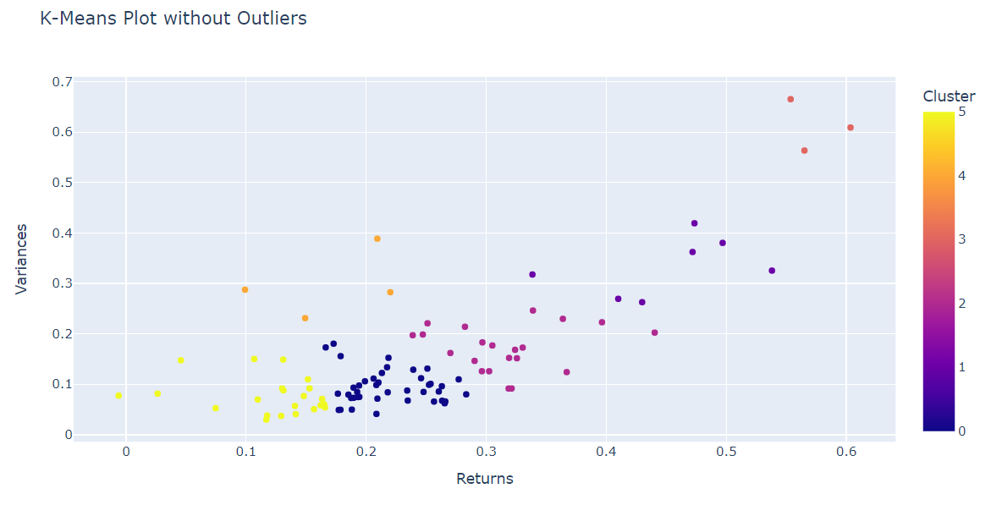
Cluster stocks
Filter out the outliers
Notes:
Chris just adding a note in here: I wouldn’t worry about changing the calculation, but I believe the annual return
Would be best calculated using the geometric return: https://www.indeed.com/career-advice/career-development/how-to-calculate-annualized-return#:~:text=An%20annualized%20return%2C%20which%20may,period%20with%20consideration%20of%20compounding.
If you want to annualize it based on trading days in the year, do: cumprod() of last return in df ^(252/numTrades)
#Calculate annual mean returns and variances
daily_returns = df.pct_change()
# 252 represents the typical number of trading days in a year for the US stock market.
#365 days in a year.
#If you subtract weekends (104 days), you're left with 261 days.
#On top of that, there are usually a few holidays (about 9 in the US) when the markets are closed.
#So, 261 - 9 = 252 trading days approximately.
annual_mean_returns = daily_returns.mean() * 252
annual_return_variance = daily_returns.var() * 252 daily_returns is presumably a pandas DataFrame or Series containing daily returns data.
daily_returns.var() calculates the variance of the daily returns. It's computed using the following formula:
Variance = Σ [(xᵢ - μ)²] / (N - 1)
Σ represents the sum over all data points.
xᵢ represents each individual daily return.
μ represents the mean (average) of the daily returns.
N represents the number of data points (in this case, the number of daily returns).

Slide 27
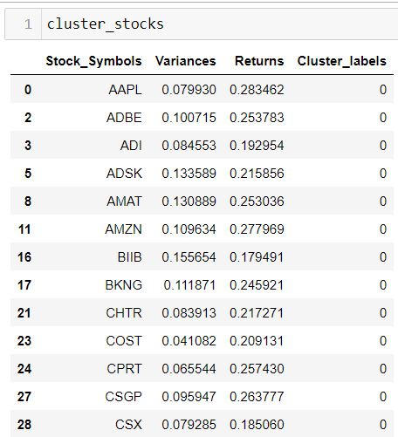
Pick top 10 of specific group
I Favor Cluster 0, so I filter the top 10.

Slide 28
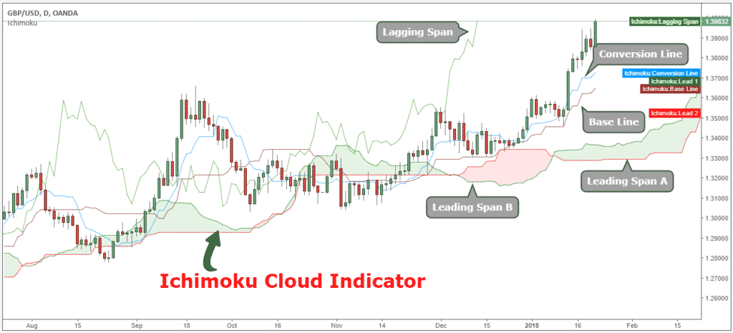
Ichimoku cloud
Momentum indicator used to recognize the direction of the trend
Notes:
Ichimoku Cloud Explained
The Ichimoku Hinko Hyo is a momentum indicator used to recognize the direction of the trend. It can also define accurate support and resistance levels. The Ichimoku Cloud indicator consists of five main components that provide you with reliable trade signals:
Tenkan-Sen line also called the Conversion Line, represents the midpoint of the last 9 candlesticks. It’s calculated with the following Ichimoku formula: [(9-period high + 9-period low)/2].
Kijun-Sen line also called the Base Line, represents the midpoint of the last 26 candlesticks. It’s calculated with the following formula: [(26-period high + 26-period low)/2].
Chiou Span also called the Lagging Span, lags behind the price (as the name suggests). The Lagging Span is plotted 26 periods back.
Senkou Span A also called the Leading Span A, represents one of the two Cloud boundaries and it’s the midpoint between the Conversion Line and the Base Line: [(Conversion Line + Base Line)/2]. This value is plotted 26 periods into the future and it’s the faster Cloud boundary.
Senkou Span B or the Leading Span B, represents the second Cloud boundaries and it’s the midpoint of the last 52 price bars: [(52-period high + 52-period low)/2]. This value is plotted 52 periods into the future and it’s the slower Cloud boundary.
Chikou Span represents the closing price and is plotted 26 days back.
When the price is above the Cloud, we’re in a bullish trend.
When the price is below the Cloud, we’re in a bearish trend.
When the price is in the middle of the cloud the trend is consolidating or ranging.

Slide 29
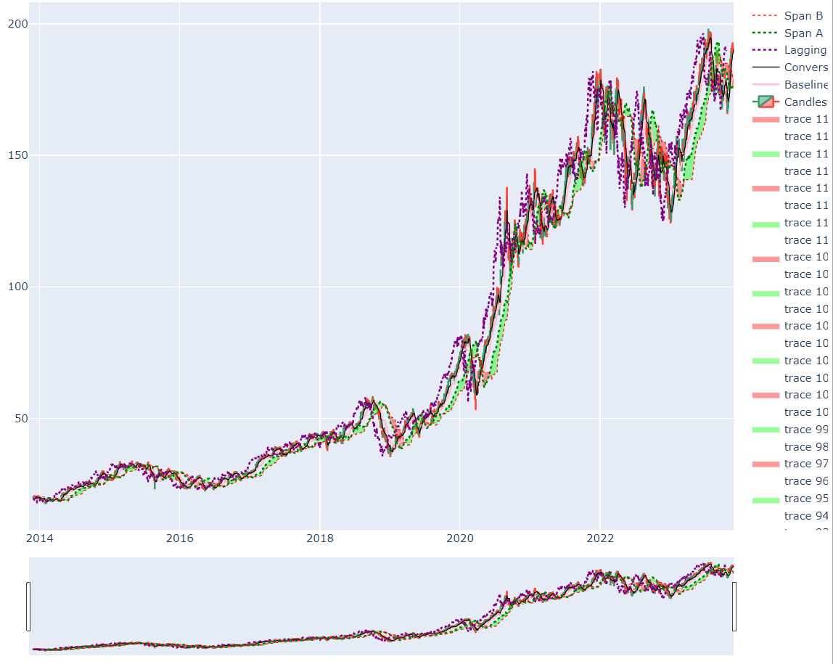
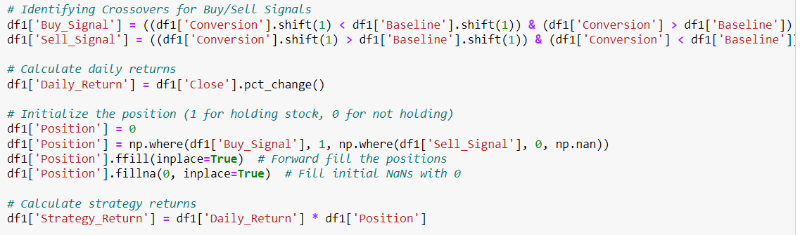
Determine when to buy or sell
Based on Ichimoku cloud, buy when the Conversion Line cross up the Base line and sell when it reverses.

Slide 30
BEST 10 YEAR RETURN
2.10x
2.48x
5.20x
Algo+Ichimoku
Algo+Ichimoku
TDB908
Cluster 5 low volatility, good return
Cluster 1 high volatility, high return
TD Nasdaq Index Mutual Fund

Slide 31
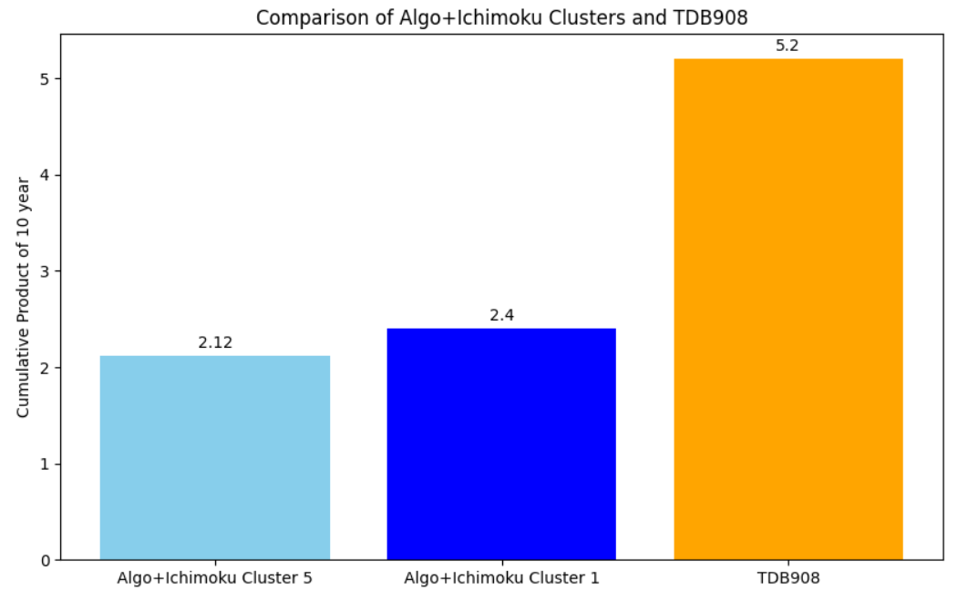
Comparision cumprod 10 years

Slide 32
4
Golden Cross
Trade high period SMAs
(50 & 200)

Slide 33
Strategy #4
Select the top 10 holdings of the TDB908 Mutual fund
Apply 2 Simple Moving Averages (SMA) based on the daily closing price
Calculate the 50 period SMA
Calculate the 200 period SMA
Buy when the 50 SMA crosses above the 200 SMA from below
Sell when the 50 SMA crosses below the 200 SMA from above

Slide 34
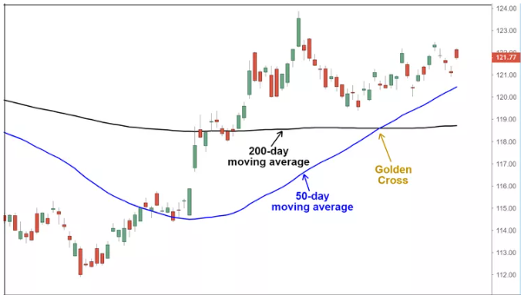
Simple Moving Average (SMA)
Calculates an average close price based on the number of periods
For example: a 50 SMA would calculate the average for the past 50 trading days
Notes:
Golden Cross Investopedia Article:
https://www.investopedia.com/terms/g/goldencross.asp
Image from webpage
https://www.investopedia.com/terms/g/goldencross.asp

Slide 35
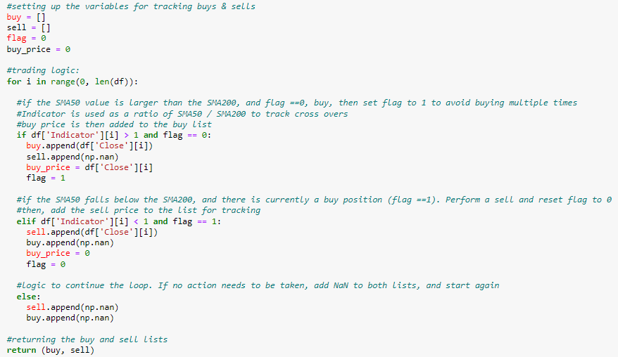
Strategy Logic
Indicator
50 SMA
200 SMA
Notes:
Golden Cross Investopedia Article:
https://www.investopedia.com/terms/g/goldencross.asp
Image from webpage
Indicator = 50SMA / 200 SMA
When Indicator > 1, then means a cross from the bottom (Buy)
When Indicator < 1, means a cross from above (Sell)

Slide 36
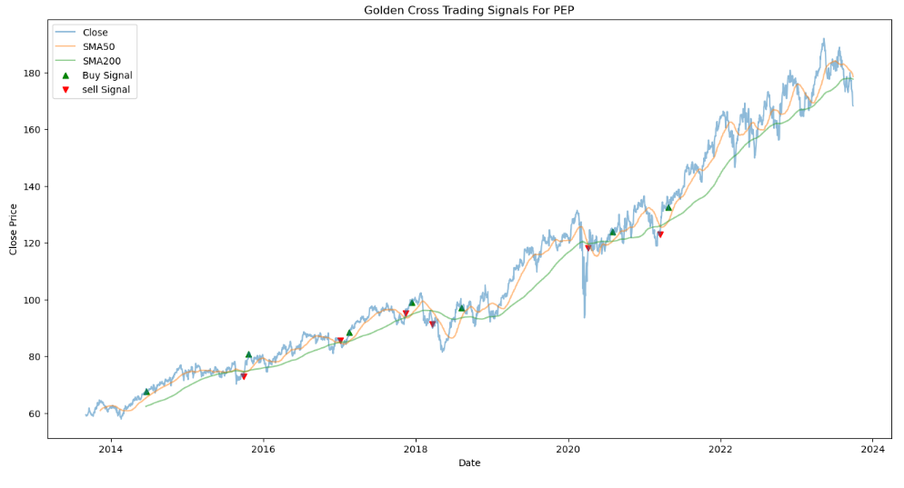
Golden Cross In Action

Slide 37
Average 10 Year Return
8.22X
5.20x
Golden Cross
TDB908
TD Nasdaq Index Mutual Fund
SMA With TDB908
Top 10 Holdings

Slide 38
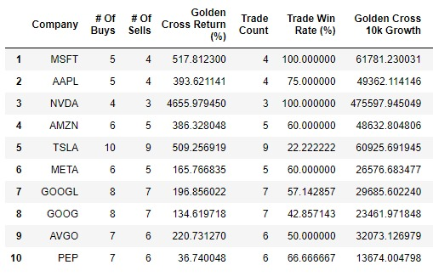
All Comparisons (SMA)

Slide 39
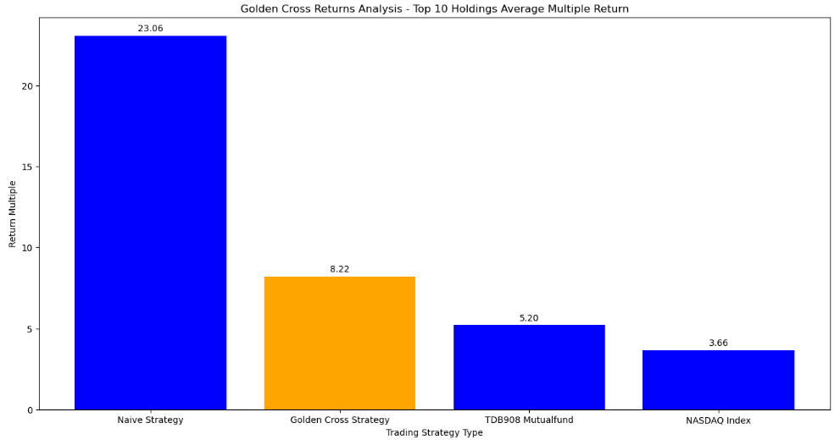
All Comparisons (SMA)

Slide 40
5
Bollinger Bands
Range-bound logic

Slide 41
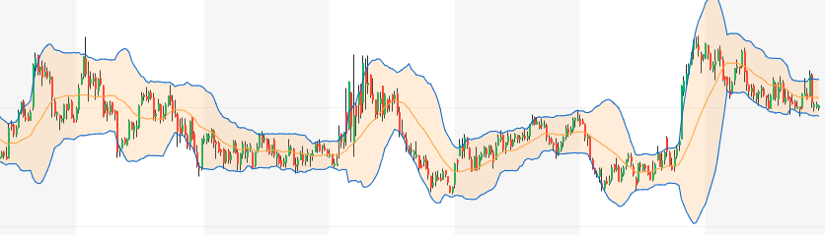
Strategy #5
Select the top 10 holdings of the TDB908 Mutual fund
Bollinger Bands (BB) measure the standard deviation 2 steps above and below the mean SMA, creating “Bands” encasing the share price movement
Buy & Sell based on share price “bounces” off the bands
Notes:
Information on Bollinger Bands:
https://www.tradingview.com/support/solutions/43000501840-bollinger-bands-bb/
Image from: Yahoo Finance – Gilead Sciences, Inc (GILD)

Slide 42
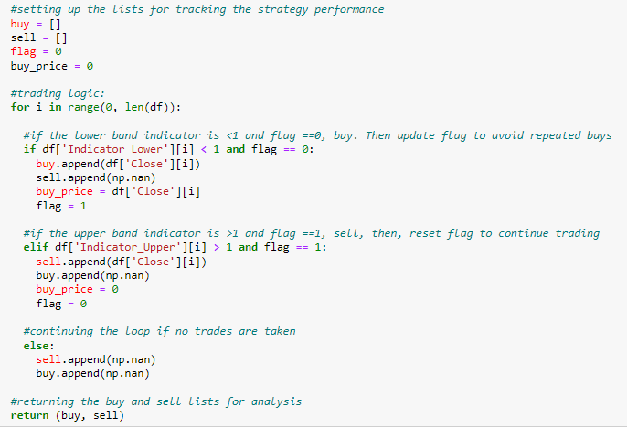
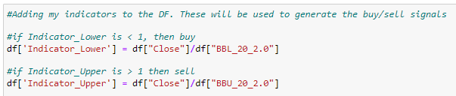
Strategy Logic
2
Indicators
Notes:
Bollinger Band Article From Trading View:
https://www.tradingview.com/support/solutions/43000501840-bollinger-bands-bb/
Indicator Lower = Close / Lower Band
Indicator Upper = Close / Upper
When Indicator Lower < 1, Price just closed below the bands (Buy)
When Indicator Upper > 1, Price just closed above the bands (Sell)

Slide 43
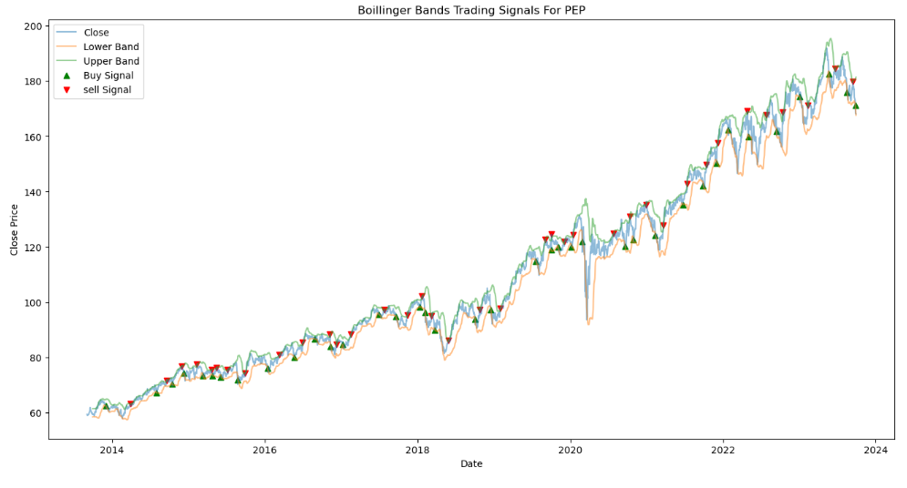
Bollinger Bands In Action
Strategy Risk:
Downward Trend
Notes:
Based on the trading logic applied. There is high risk of loss in a downwards trend pattern.
That is why focus is finding range-bound companies to minimize trading risk
Strategy will also “miss out” on gains from rising trends

Slide 44
10 Year Return
3.73X
5.20x
Bollinger Bands
TDB908
TD Nasdaq Index Mutual Fund
Bollinger Bands With TDB908 Top 10 Holdings

Slide 45
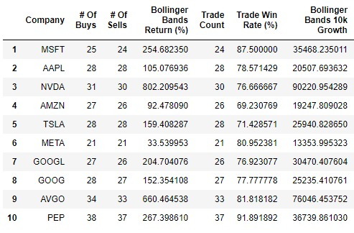
All Comparisons (BB)

Slide 46
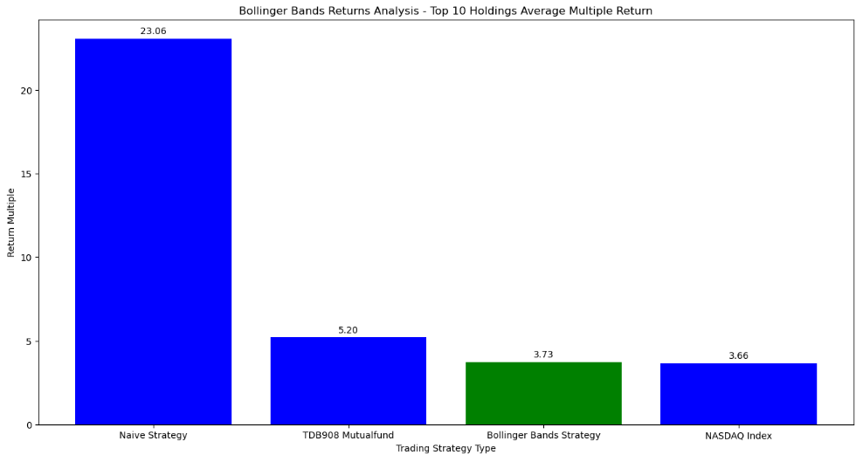
All Comparisons (BB)

Slide 47
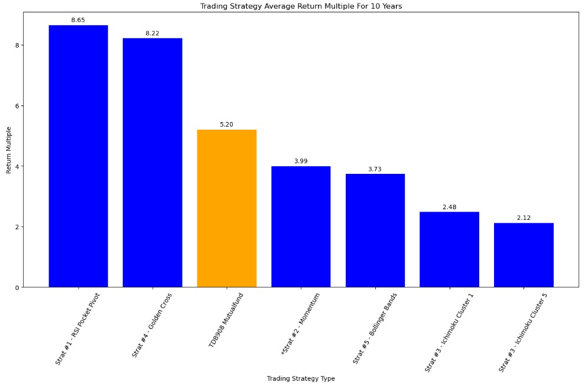
Strategies Summary
*Momentum return multiple is estimated based off the 5 year performance, extrapolated for 10 years
Notes:
Momentum return was estimated by taking the 5yr return multiple, converting to an annual
Return %, then compounding it for 10 years. Result was then 2.99+1 to arrive at the multiple

Slide 48
thanks!
Do you have any Questions?

Slide 49
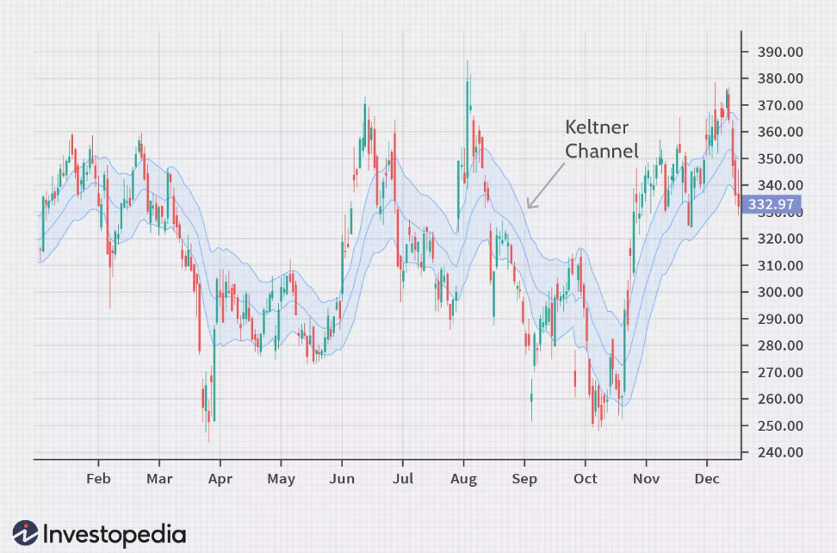
Indicators
Keltner channel
Keltner Channels are volatility-based bands that are placed on either side of an asset's price and can aid in determining the direction of a trend.
Notes:
The exponential moving average (EMA) of a Keltner Channel is typically 20 periods, although this can be adjusted if desired.
The upper and lower bands are typically set two times the average true range (ATR) above and below the EMA, although the multiplier can also be adjusted based on personal preference.

Slide 50
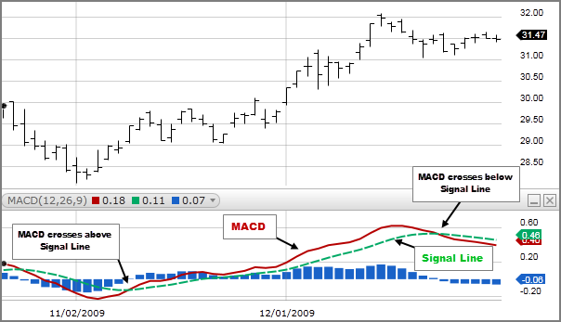
Indicators
Moving Average Convergence/Divergence (MACD)
An approximated MACD can be calculated by subtracting the value of a 26 period Exponential Moving Average (EMA) from a 12 period EMA.
A signal line is created with a 9 period EMA of the MACD line.
Notes:
The Moving Average Convergence/Divergence indicator is a momentum oscillator primarily used to trade trends. Although it is an oscillator, it is not typically used to identify over bought or oversold conditions. It appears on the chart as two lines which oscillate without boundaries. The crossover of the two lines give trading signals similar to a two moving average system.

